Slide 1
Introduction to Configuration & Source Management
Università di Modena e Reggio Emilia
Prof. Nicola Bicocchi (nicola.bicocchi@unimore.it)

Slide 2
ICT Company (large dimension)
Multinational Company
Up to 200 employees working together
Multiple working location across the world
Different spoken languages
Flexible working hours
Different approaches to work
Well-defined hierarchical roles

Slide 3
Configuration Management
Configuration Management (ITILv3): «The Process responsible for maintaining information about Configuration Items required to deliver an IT Service, including their Relationships.»
Key part of the Agile manifesto
Set of processes designed to manage and control objects of complex systems

Slide 4
Parallel between SCM and cooking
Source Code Management: Accurately verify weigh and measure ingredients
Build Engineering: shake ingredients and “make a cake”
Environment Configuration: check the shop window is ready for sell the cake
Change Control: choose when the cake is ready to be selled
Release engineering: put the cake in the shop window so people can see it but they can’t buy it
Deployment: deliver the cake to the customer

Slide 5
Source Management
Precursor of the Configuration Management
Affects the product quality and the team productivity
Often understimated

Slide 6
Goals
Create a vault for all source codes: no source code mustn’t get lost
Increase productivity of the work teams (e.g., manage more than one development team)
Traceability: Everyone know who change the code and when, if necessary, be able to rollback to a previous version of the source code

Slide 7
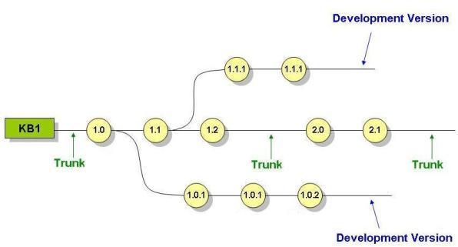
Basic Concepts

Slide 8
Basic Concepts(1)
Baseline: Identify the exact version number of each source contained in a specific software release. Virtual time machine allows to move through versions

Slide 9
Basic Concepts(2)
Trunk: Baseline of a software production.
Changes on trunk often reflects in a new software release (e.g., iOS7 –> iOS8)

Slide 10
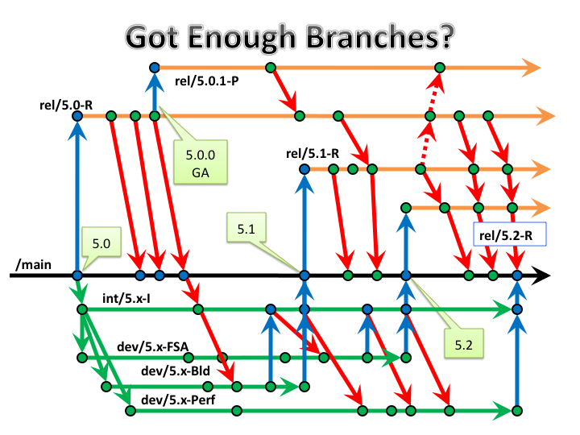
Basic Concepts(3)
Branch: parallel baseline to the trunk, of which it take some characteristic at a given instant of time. The branch is used for minor changes or product customization. (e.g., different versions of the same application Unix, Windows, Mac). Use with caution!

Slide 11
Basic Concepts(4)
Merging: inverse of branching. Can be used to merge changes from branch to trunk at specific instant of time. Usually this operation leads to a new release.

Slide 12
Basic Concepts(5)
Workspace: clone of the global repository stored in a private local directory. The workspace allows each user to work on a local and private copy

Slide 13
Basic Concepts(6)
Check in / Check out: download/upload of sources from/to a Source Management

Slide 14
Git
Source code Management software
Distributed
Open Source
Keep track of version your files is in
Can merge different lines of development and integrate them into a single baseline
Used by many companies like: Google, Facebook, Twitter, Microsoft, Netflix, …

Slide 15
Git - workflow

Slide 16
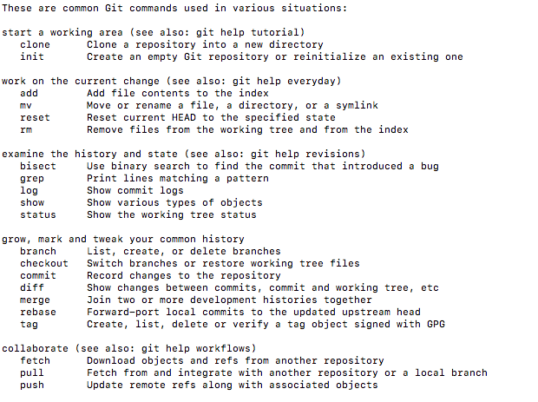
Git base commands(1)

Slide 17
Git base commands (2)
Init: Initialize empty Git repository in the working directory
Usage: git init <workingDirectory> Initialize a repo with .git
Clone: Clone a repository in the working directory
Usage: git clone <repositoryUrl>
Add: add an untracked/modified file to staging area
Usage: git add <fileName>
These files are not commited yet!

Slide 18
Git base commands (3)
Commit: commit staged files to the local repository
Usage: git commit –m ”commit message”

Slide 19
Git base commands (4)
branch/merge commands:
The branch command has the effect of creating a new branch of the repository
Usage: git branch <new_branch_name>

Slide 20
Git base commands (5)
merge: has the effect of merging a branch into your current master (integrate all the commits of your branch)
Usage: git merge <branch_to_merge>
Changes from new feature-branch merged into master

Slide 21
Merge conflicts
What happens when merging and there are two commits contains different changes to same line?
file1
file1
Apple
Carrot
master
branch

Slide 22

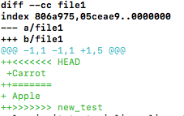
Merge conflicts (1)
Git will notice conflicts in the files
Use: git diff <fileName> to check conflicts
Solutions:
Manually fix the conflict
Abort the merge using: git merge -abort

Slide 23
Git base commands (6)
Remote commands: push/pull
git push: to push commits made on your local branch to a remote repository
git pull: to fetch from remote repository and merge with the local one
Note that conflicts during the merge phase occurs locally!

